Slide 1
.NET Core Microservices
Cesar de la Torre
Sr. Program Manager
.NET Product Team
Microsoft Corp.
Glenn Condron
Sr. Program Manager
ASP.NET Product Team
Microsoft Corp.
Twitter: @cesardelatorre
Email: cesardl@microsoft.com
Twitter: @condrong
Email: glennc@microsoft.com

Slide 2
Introduction to .NET on Docker

Slide 3
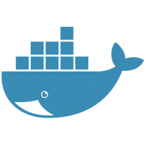


Docker Containers
Docker helps automating the deployment of applications as portable, self-sufficient containers that can run on any cloud or on-premises.
No more:
“It works in my dev machine!...
Why not in production?”
Now it is:
“If it works in Docker, it works in production”
Key words about WHY Docker?
Dependencies (self-sufficient)
Deployment
Notes:
Docker is also a company promoting and evolving this technology with a tight collaboration with cloud, Linux and Windows vendors, like Microsoft.

Slide 4

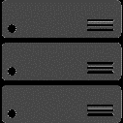

Virtual Machines
compared to
Docker Containers
App 1
App 2
App 3
Bins/Libs
Bins/Libs
Bins/Libs
Guest OS
Guest OS
Guest OS
App 1
App 2
App 3
Bins/Libs
Bins/Libs
Bins/Libs
Hypervisor
Container Engine
Host Operating System
Operating System
Infrastructure
Infrastructure

Slide 5
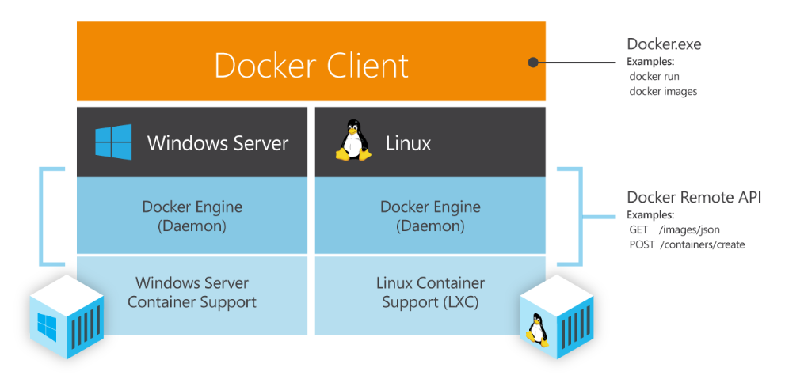
Docker Engine for Linux and Windows
Notes:
We’ve been making significant progress towards enabling multi-container, distributed applications in the past few months. Composing multi-Docker container applications will become significantly easier as we integrate Fig into Docker. We’ve also been making progress on other critical capabilities for orchestration including provisioning and managing Docker hosts, creating clusters of Docker hosts, and inter-Docker container networking, all of which will be previewed this quarter.
Microsoft’s endorsement and early work with our orchestration APIs is hugely exciting. Microsoft and Docker share a common vision that multi-container applications should be assembled using both Dockerized Windows and Dockerized Linux components. The two companies will work with emergent infrastructure tools for multi-container applications like Kubernetes, Mesos, Helios etc. to provide a uniform Docker interface that provides developers with multi-platform orchestration capabilities leveraging Dockerized content from these two ecosystems.

Slide 6
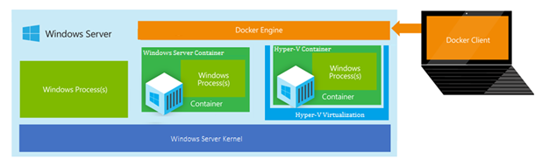
Windows Server Docker Containers
Notes:
We’ve been making significant progress towards enabling multi-container, distributed applications in the past few months. Composing multi-Docker container applications will become significantly easier as we integrate Fig into Docker. We’ve also been making progress on other critical capabilities for orchestration including provisioning and managing Docker hosts, creating clusters of Docker hosts, and inter-Docker container networking, all of which will be previewed this quarter.
Microsoft’s endorsement and early work with our orchestration APIs is hugely exciting. Microsoft and Docker share a common vision that multi-container applications should be assembled using both Dockerized Windows and Dockerized Linux components. The two companies will work with emergent infrastructure tools for multi-container applications like Kubernetes, Mesos, Helios etc. to provide a uniform Docker interface that provides developers with multi-platform orchestration capabilities leveraging Dockerized content from these two ecosystems.

Slide 7
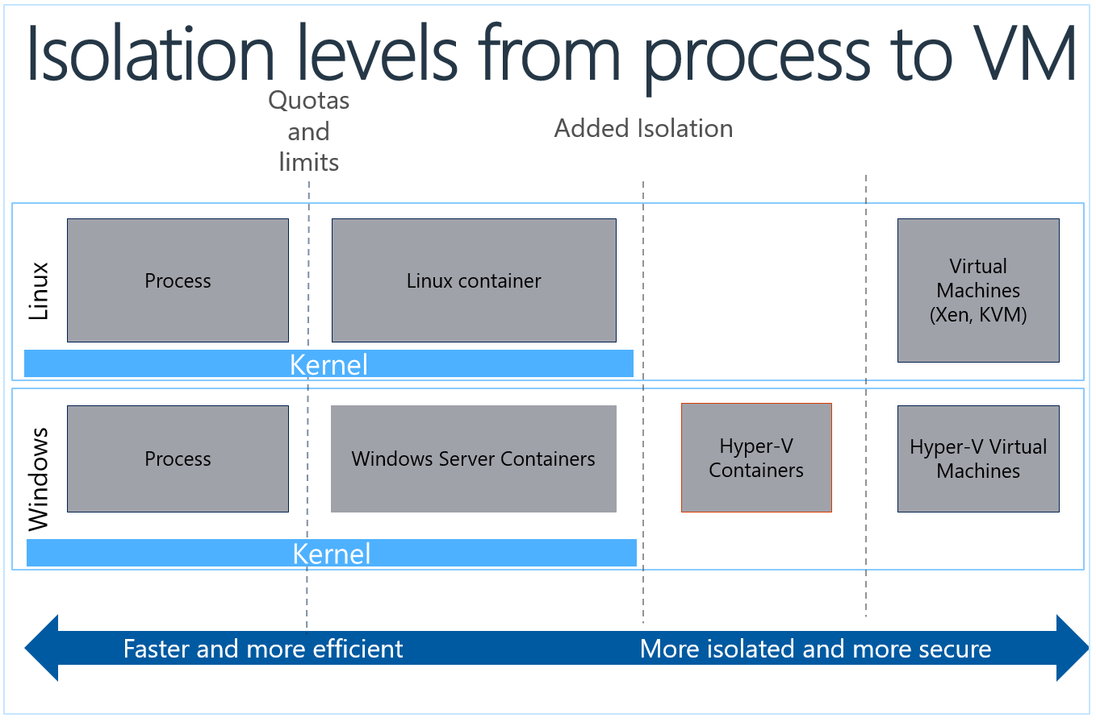



Slide 8
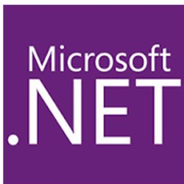
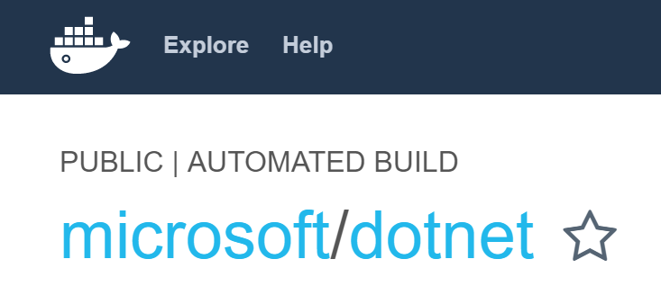
Docker and .NET
.NET Core Docker images
xPlat. (Linux & Windows)
.NET Framework images
Windows only
See at Docker Hub

Slide 9
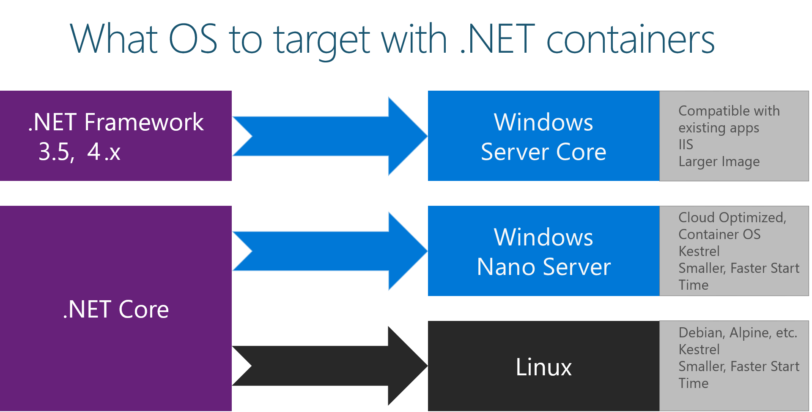

Slide 10
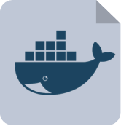
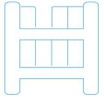

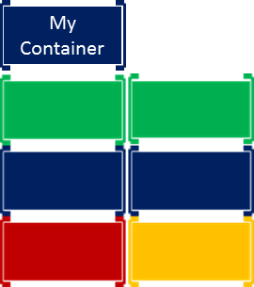






Inner-Loop development workflow for Docker apps
1.
2.
3.
4. (opt)
5.
6.
Write
Dockerfile/s
Create Images defined at Dockerfile/s
Define apps
by writing
Run Containers / Compose app
Code
your app
Test
your app or
microservices
docker-compose.yml
My Containers
My Images
My Containers
docker build
docker run /
Docker-compose up
http
access…
VM
Base Images
My Images
1
2
Remote
Docker Registry
(i.e. Docker Hub)
Local
Docker Repos
7.
git push
Push or
Continue
developing
docker push
to private registry
(*) If not using CI/CD

Slide 11

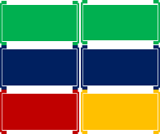
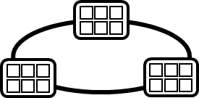

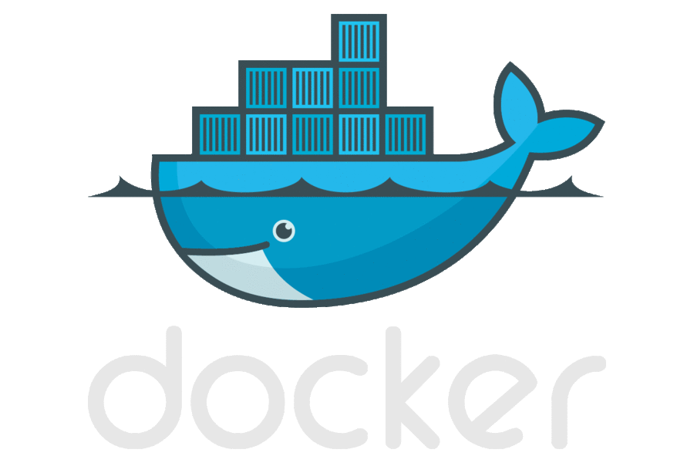

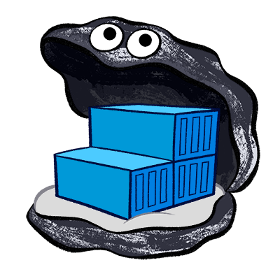
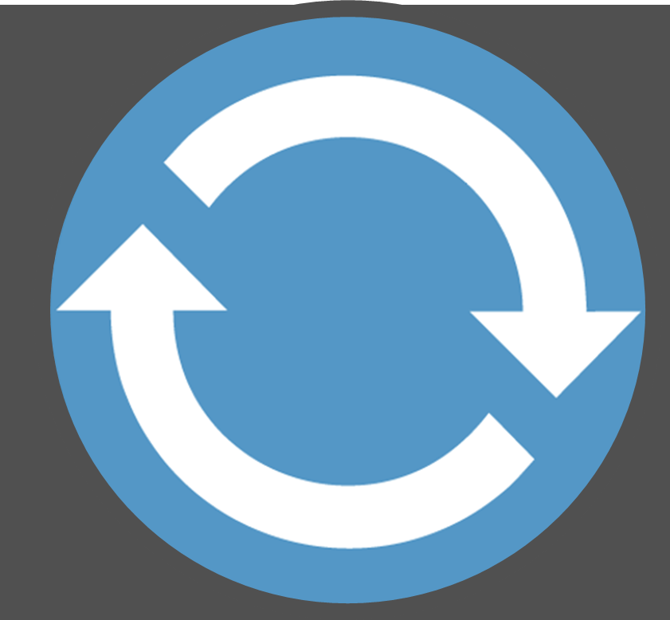
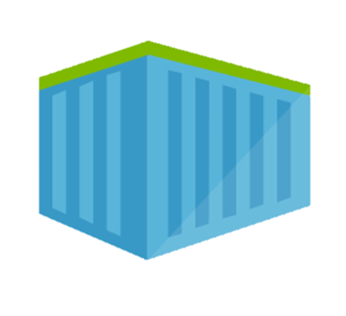
DevOps Workflow using containers
Visual Studio Team Services
Container Service
2.
3.
4.
5.
Source Code Control
(SCC)
Build/CI,
Integrate,
Test
Run, Manage
Service Fabric
CD, Deploy
Production
environments
App Services
Azure Container Registry
Push
Code
Azure Key Vault
Inner-Loop
6.
1.
Run
Monitor and Diagnose
Code
Validate
Outer-Loop
Debug
Notes:
Steve Lasker

Slide 12
Demo: .NET Core on Docker

Slide 13
Demo: Visual Studio Docker Tools

Slide 14
Microservices Architecture

Slide 15
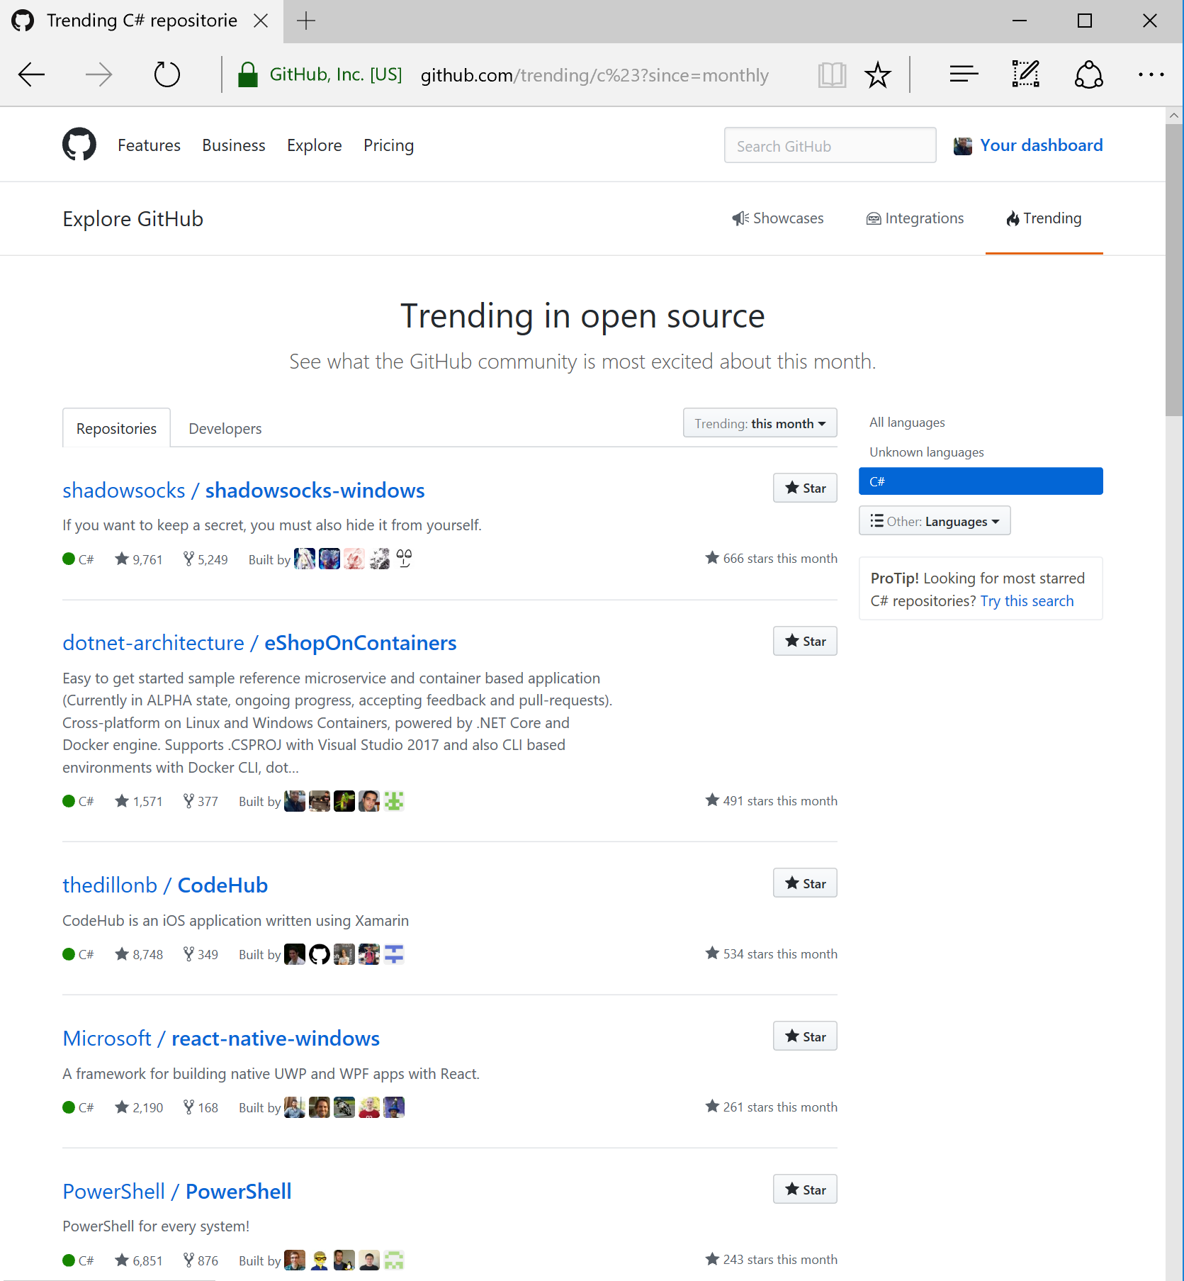
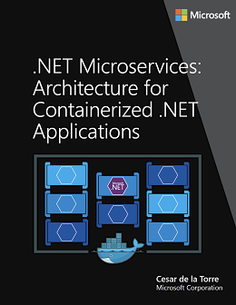
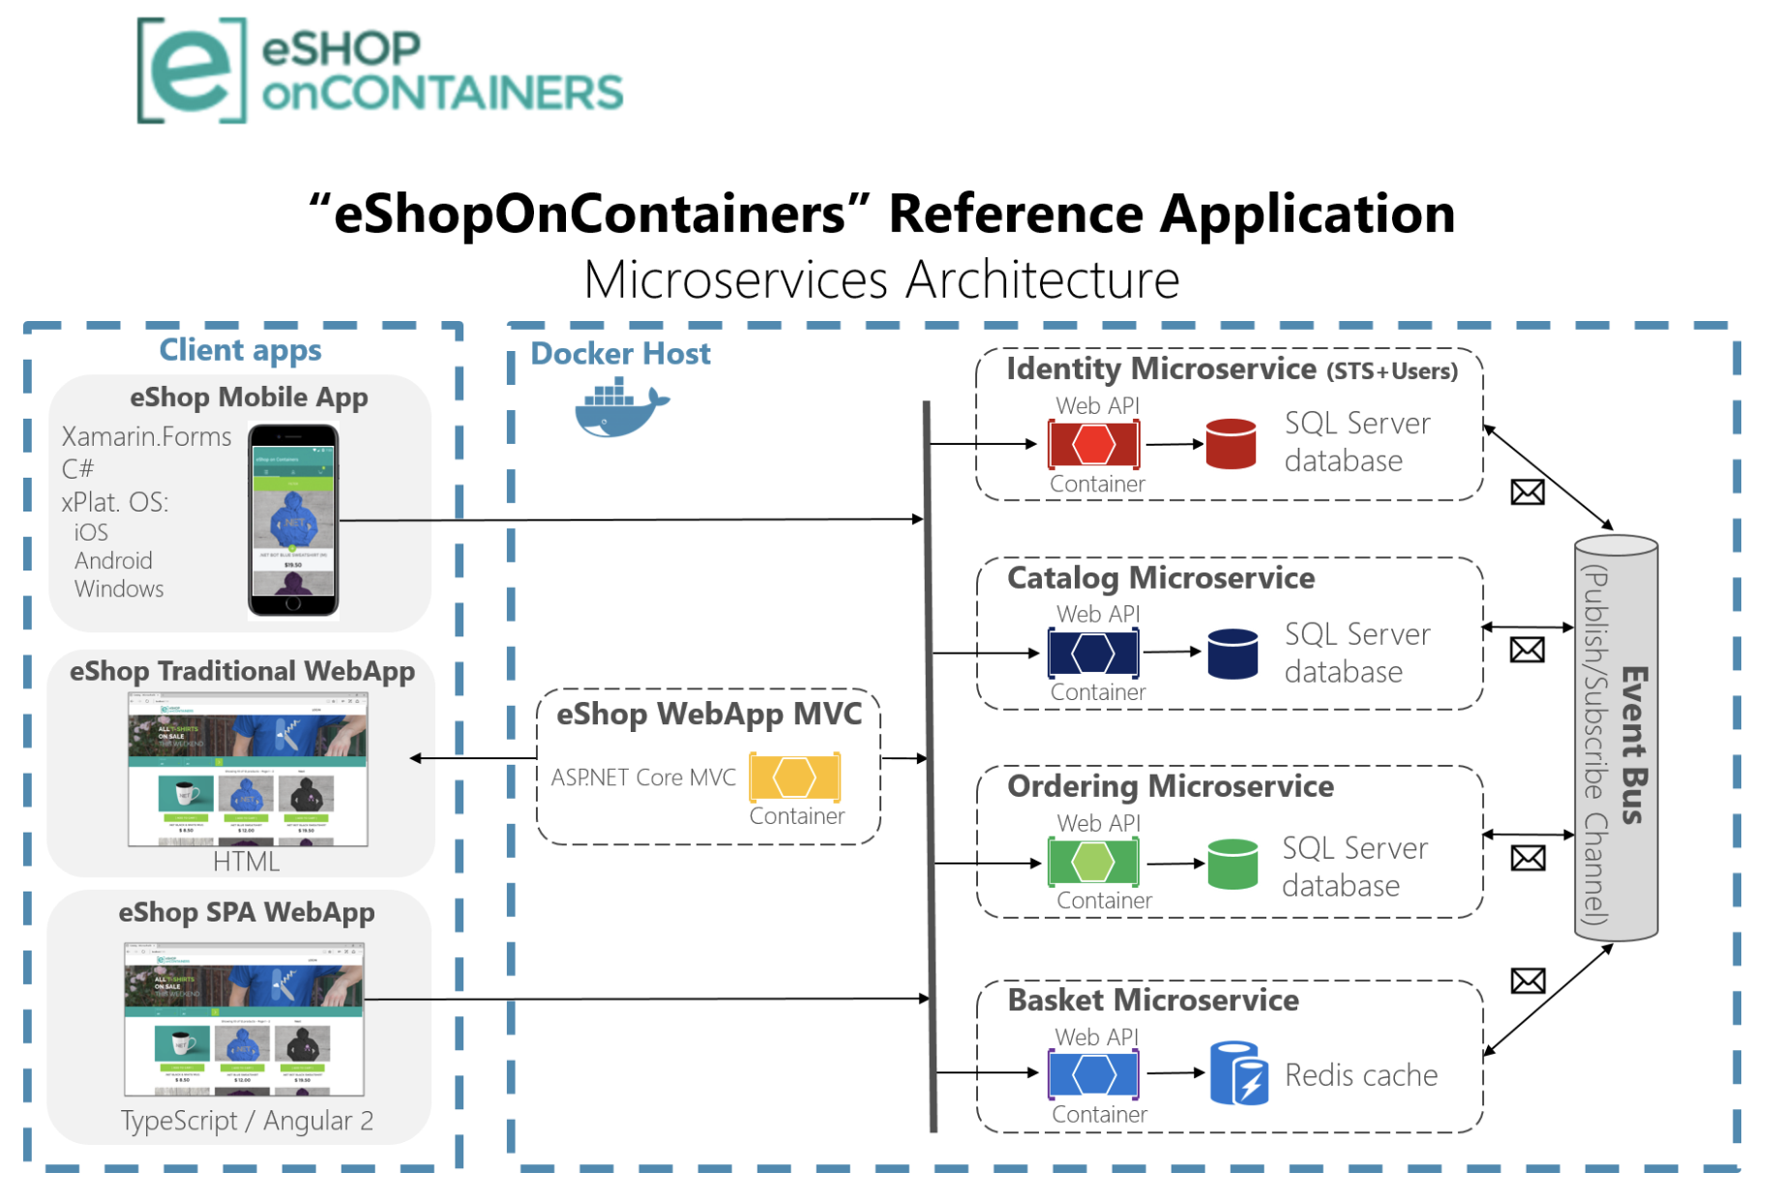
.NET microservice and container guidance
Free eBook (250+ page)
aka.ms/MicroservicesEbook
Reference application
aka.ms/MicroservicesArchitecture
Trending C# Github Repositories
#2 – Last month

Slide 16
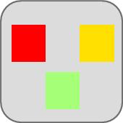
Traditional application approach
Microservices application approach
A traditional application has most of its functionality within a few processes that are componentized with layers and libraries.
Scales by cloning the app on multiple servers/VMs
App 1
A microservice application segregates functionality into separate smaller services.
Scales out by deploying each service independently with multiple instances across servers/VMs
App 1
App 2
Independent deployment of microservice
Coarse-grained density of apps/services
Fine-grained density of services
Need to deploy the full application
Notes:
30 secs

Slide 17
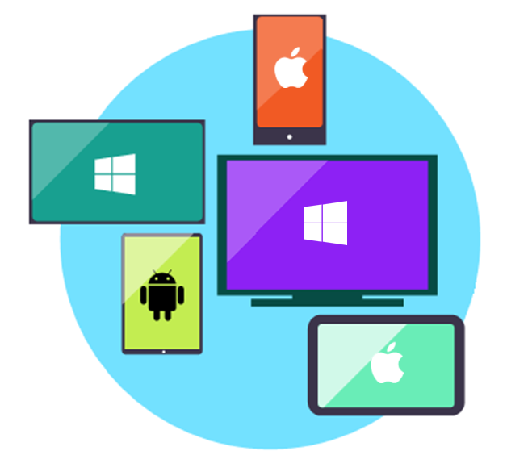
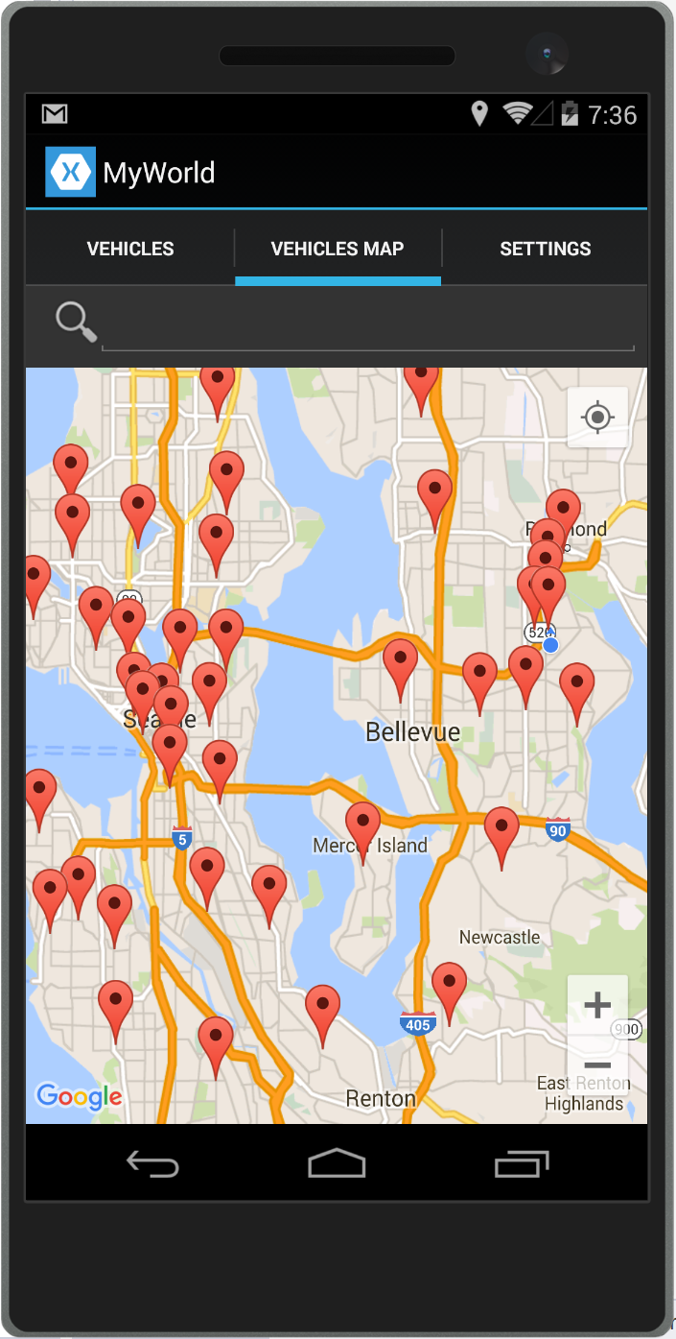
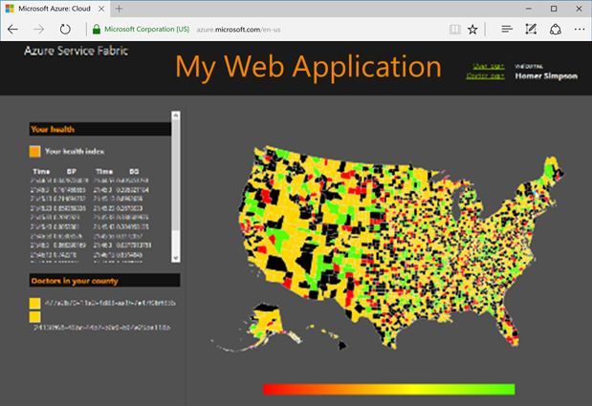

Data in Traditional approach
Data in Microservices approach
Single monolithic database
Tiers of specific technologies
Graph of interconnected microservices
State typically scoped to the microservice
Remote Storage for cold data
Web Tier
Services Tier
Cache doesn’t help much for massive data ingress (Events, IoT, etc.)
Mobile
apps
Web presentation services
Cache Tier
Database servers are usually the bottleneck
Stateless services
SQL DB
or
No-SQL
Stateful services
Data Tier
SQL
[…]
Monolithic Databases are shared across services.
Stateless services
with
separate stores
Each microservice owns its model/data!
Notes:
1 min

Slide 18
Identifying a Domain Model per Microservice or Bounded Context
Identity Microservice Model
Ordering Microservice Model
ApplicationUser
Order
Buyer
…
OrderItem
Address
Catalog Microservice Model
Basket Microservice Model
CatalogItem
Brand
Basket
BasketItem
Type
Notes:
This is just a sample, actual bounded context boundaries would depend on your real Domains. Depending on each Domain, the entities and their position could be different.

Slide 19
Demo eShopOnContainers and Docker Containers
Focus on:
Docker-compose.yml & Debugging Multi-Containers App
Simple CRUD microservice
vs
DDD & CQRS microservice
Retries and Circuit breakers
Health Checks

Slide 20

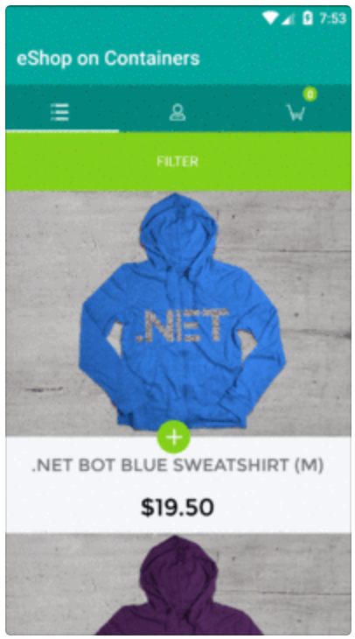
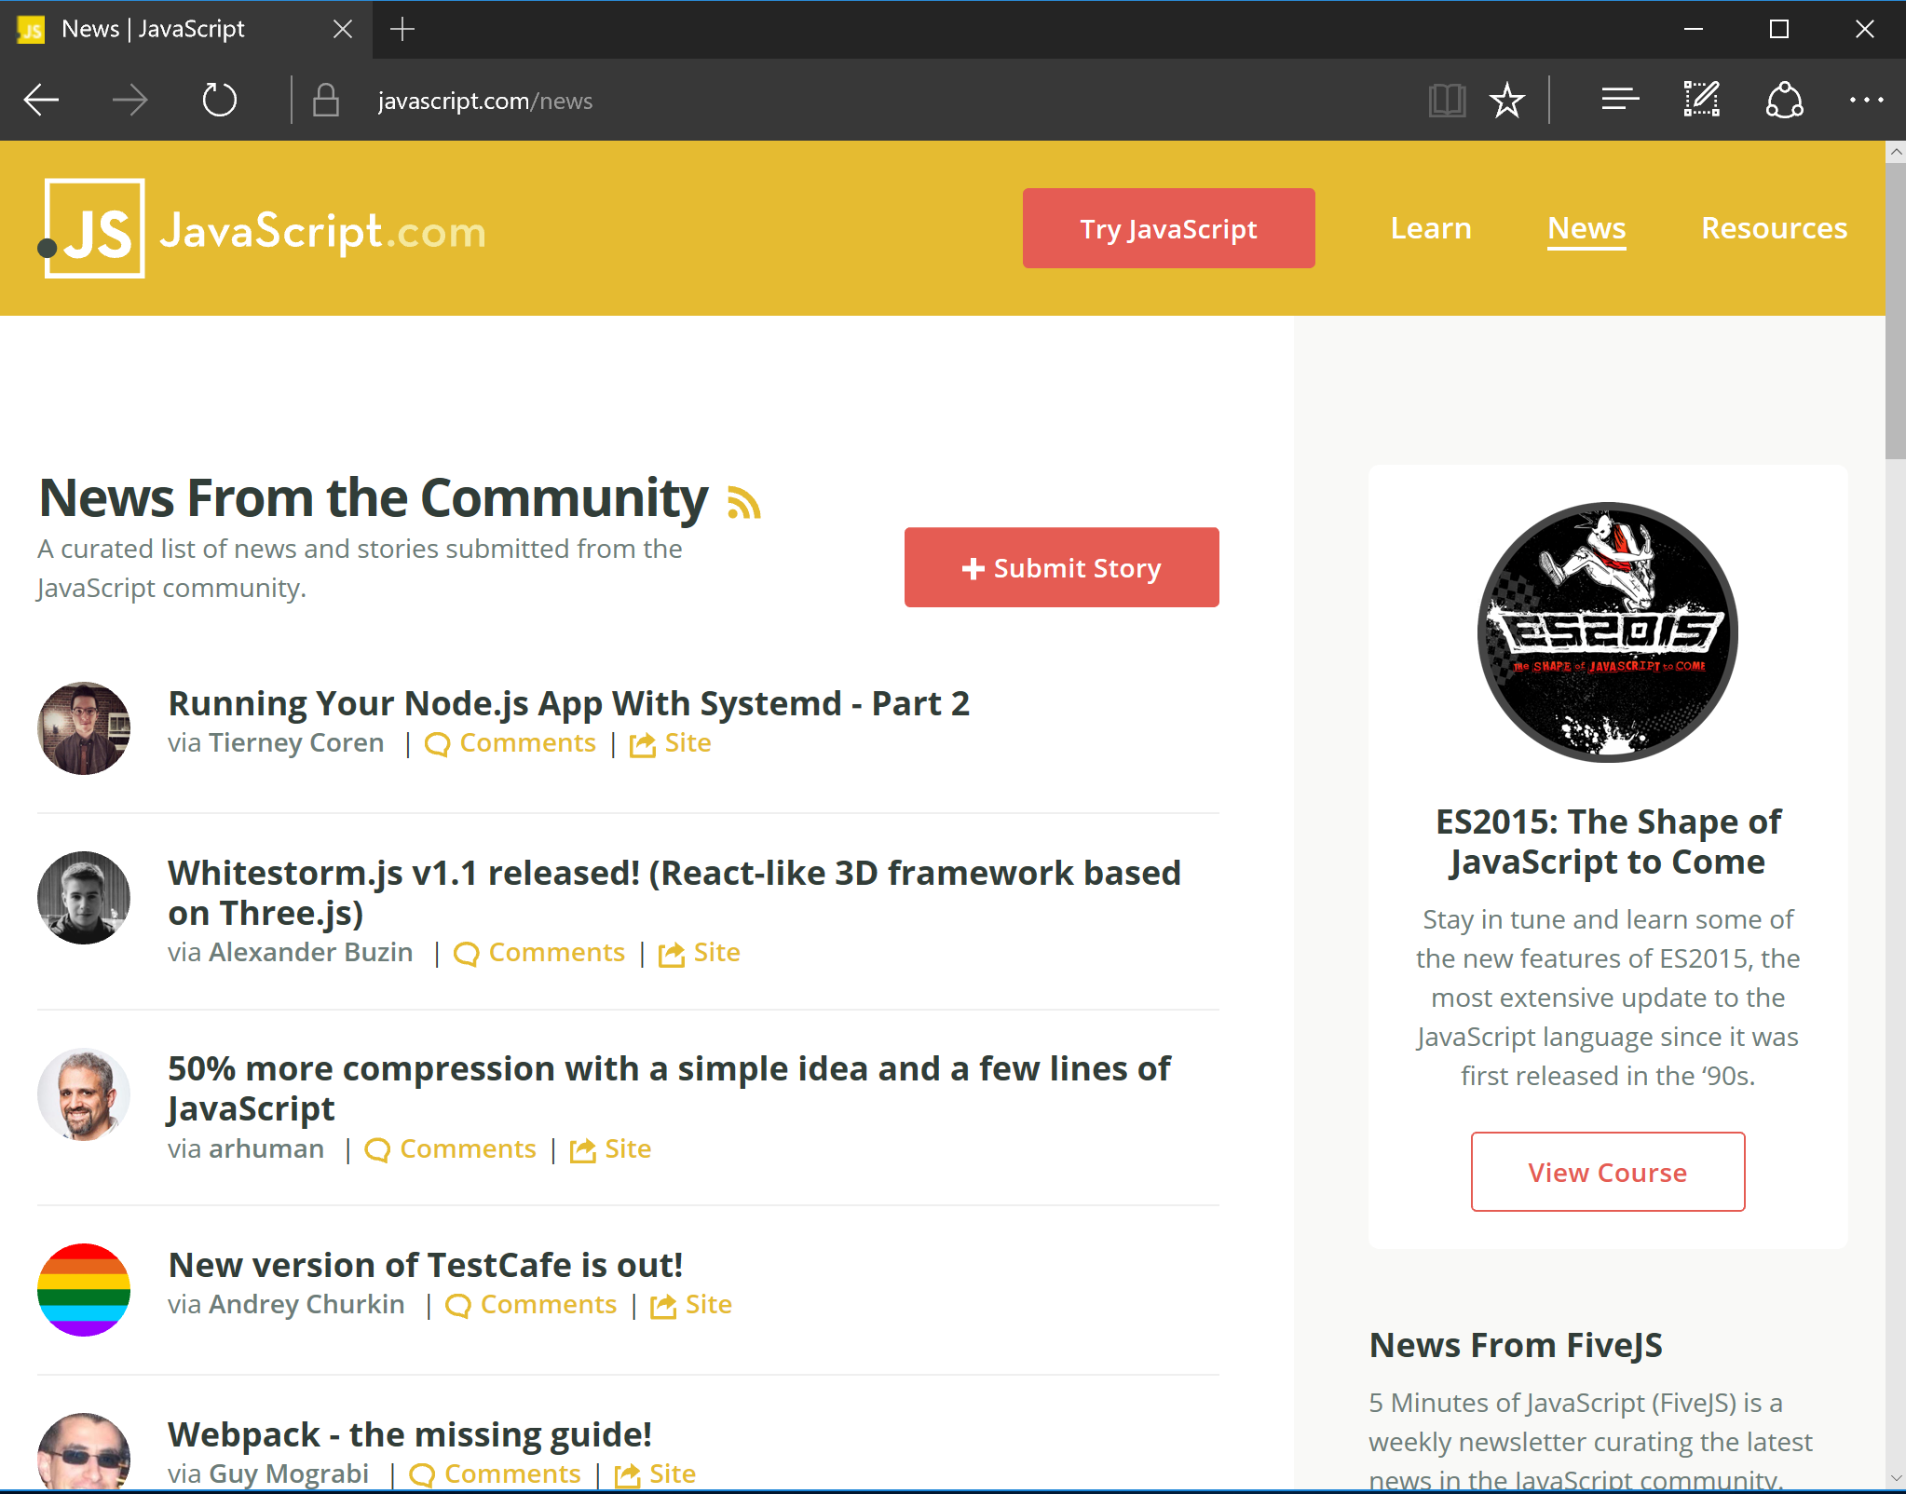
Request/Response Communication for Live Queries and Updates
HTTP based Services
Client Mobile App
Back end
With
Retries w/ exponential backoff & Circuit-Breakers
Microservice 1
JSON
Web API
Container
Client SPA WebApp
API Gateway
Microservice 2
ASP.NET Core
Web API
Web API
JSON
HTTP
Container
Container
Request/Response
JavaScript / Angular.js
HTTP
Request/Response
Microservice 3
Web API
Traditional WebApp
Browser
Client WebApp MVC
Container
Implement resilient communication
ASP.NET Core MVC
Container
Implement resilient communication
HTML
HTML

Slide 21
Risk of Partial Failure Amplified in Microservices
HTTP request/response communication
Backend / Orchestrator
Multiple
Customers
Dependency
1
Dependency
2
Browser
Web App
Multiple
HTTP requests
Dependency
3
Dependency
5
Submit Order page
Dependency
6
Dependency
4
Dependency
7

Slide 22

Implementing Asynchronous Event-Driven communication with an Event Bus
Backend
Basket Microservice
Database as
Cache
User-Profile Microservice
Service
1
Web API Service
3
UserUpdated event → Buyer info
UpdateUser
command
Event Bus
(Publish/Subscribe Channel)
UserUpdated event
(Publish Action)
4
2
UserUpdated event → Buyer info
DB update
Event Bus Abstractions/Interface
Ordering Microservice
Database
Event Bus Implementations
Azure
Service
Bus
Other:
NServiceBus
MassTransit
etc.
Database
RabbitMQ
Service
Eventual consistency across microservices’ data based on event-driven async communication

Slide 23
Developing Microservices with ASP.NET Core
ASP.NET Core – Web API services
Unified controllers
Dependency Injection out-of-the-box
ASP.NET Core Middleware
Implement techniques for resilient cloud apps
Http call retries with exponential backoff, Circuit breakers, etc. (i.e. Polly’s policies)
Use sync. Http for client apps up to 1st level of internal microservices, ideally
Use async. message based comm. across internal microservices
Notes:
This slide is required. Do NOT delete. This should be the first slide after your Title Slide. This is an important year and we need to arm our attendees with the information they can use to Grow Share! Please ensure that your objectives are SMART (defined below) and that they will enable them to go in and win against the competition to grow share. If you have questions, please contact your Track PM for guidance. We have also posted guidance on writing good objectives, out on the Speaker Portal (https://www.mytechready.com).
This slide should introduce the session by identifying how this information helps the attendee, partners and customers be more successful. Why is this content important?
This slide should call out what’s important about the session (sort of the why should we care, why is this important and how will it help our customers/partners be successful) as well as the key takeaways/objectives associated with the session. Call out what attendees will be able to execute on using the information gained in this session. What will they be able to walk away from this session and execute on with their customers.
Good Objectives should be SMART (specific, measurable, achievable, realistic, time-bound). Focus on the key takeaways and why this information is important to the attendee, our partners and our customers.
Each session has objectives defined and published on www.mytechready.com, please work with your Track PM to call these out here in the slide deck.
If you have questions, please contact your Track PM. See slide 5 in this template for a complete list of Tracks and TPMs.

Slide 24
Demo eShopOnContainers and Docker Containers
Focus on:
Retries and Circuit breakers
Health Checks
Event Bus & messaging

Slide 25




Orchestrator’s Cluster managing microservices/containers
App 1
App 2
Clusters provide:
High scalability
Automatic High Availability and resiliency
High services density per host
My Docker Images
My ASP.NET Core Services
Official Docker Images
https://hub.docker.com
Cluster of
Nodes/Hosts
VM
or
Notes:
For each service instance you use one container
Docker images/containers are “units of deployment”
A container is an instance of a Docker Image
A host (VM/server) handles many containers
https://blogs.msdn.microsoft.com/azureservicefabric/2016/04/25/orchestrating-containers-with-service-fabric/
Service Fabric will support the different types of containers discussed above in an upcoming release.
At a high level, containers can be seen as encapsulated, individually deployable components running as isolated instances on the same kernel, leveraging operating system level virtualization. This means that each application, its runtime, dependencies, and system libraries run inside a container with full, private access to their own isolated view of operating system constructs. Along with portability, this degree of security and resource isolation is the main benefit for using containers with Service Fabric, which otherwise runs services in traditional processes. On Linux, this isolation has traditionally been provided by cgroups and namespaces, and Windows Server Containers (coming in Windows Server 2016) will behave similarly. In addition, Windows Server 2016 will offer Hyper-V Containers, an even higher level of security isolation for hostile multi-tenant scenarios. Figure 1 shows the different isolation levels.

Slide 26

















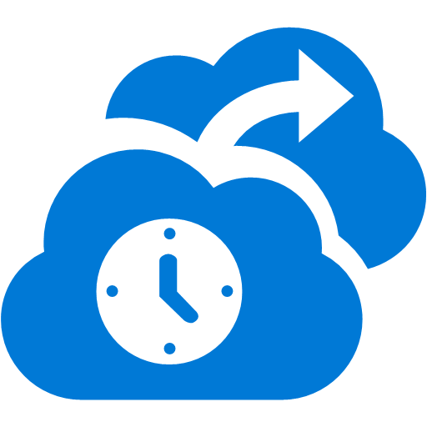



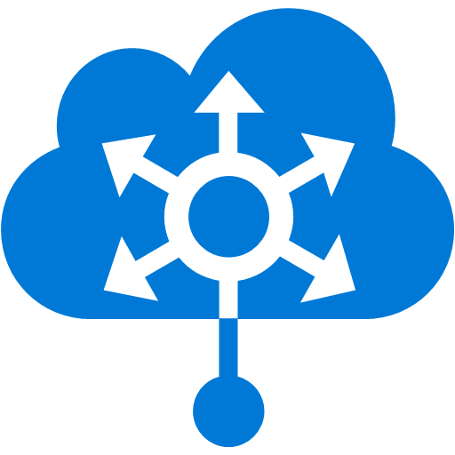










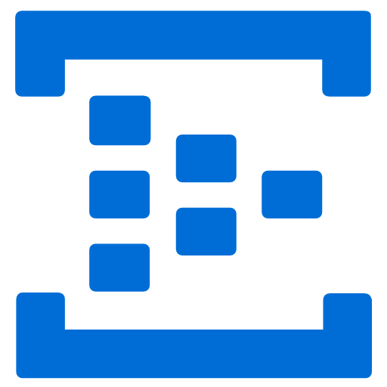














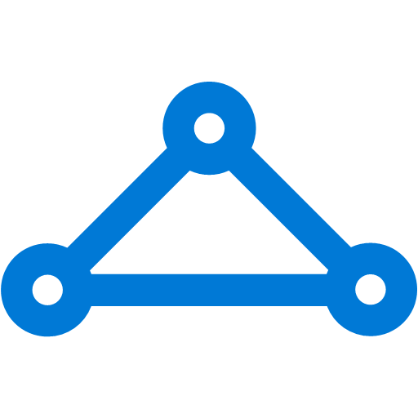


Microsoft Azure
Orchestrators for Microservices
Security & Management
Platform Services
Hybrid Operations
Portal
Compute
App Platform
Developer Services
Notification
Hubs
Azure AD
Connect Health
Cloud
Services
Service
Fabric
Web Apps
API
Apps
API
Management
Visual Studio
Azure SDK
Active
Directory
AD Privileged
Identity Mngt
Batch
Azure Container
Service
Mobile
Apps
Logic
Apps
Function
Apps
Team Project
Application
Insights
Multi-Factor
Authentication
Backup
Integration
Analytics & IoT
Data
Automation
Operational
Insights
Storage
Queues
Biztalk
Services
SQL Data
Warehouse
HDInsight
Machine
Learning
SQL
Database
Key Vault
Hybrid
Connections
Service
Bus
Import/Export
Store /
Marketplace
Data
Factory
Event
Hubs
Redis
Cache
Search
Media & CDN
Site
Recovery
Stream
Analytics
Mobile
Engagement
DocumentDB
Tables
VM Image Gallery
& VM Depot
Media
Services
Content Delivery
Network (CDN)
StorSimple
Infrastructure Services
Compute
Storage
Networking
Windows
Linux
Containers
BLOB Storage
Azure Files
Premium Storage
Virtual Network
Load Balancer
DNS
Express
Route
Traffic Manager
VPN Gateway
Application Gateway

Slide 27
Azure Compute Continuum
IaaS
PaaS
VMs /
VM Scale Sets
VM Extensions
Orchestrators
ACS &
Service Fabric
App Service
&
Azure Functions
Ultimate
Control
Rapid
Development

Slide 28
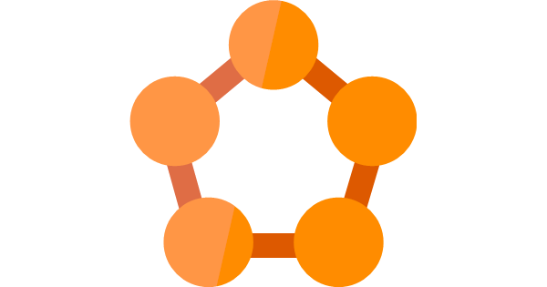
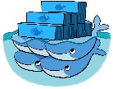
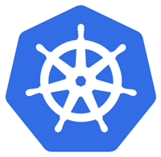
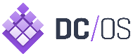
Choosing Orchestrators in Azure
Azure Product
Orchestrator | Description | Good for | Common workloads
 | Azure Service Fabric is a distributed systems platform that makes it easy to package, deploy, and manage scalable and reliable microservices |  | Stateful svc & Actors Microservices based on plain processes Microservices based on containers
 | Docker Swarm is a clustering and scheduling tool for Docker containers. With Swarm, IT administrators and developers can establish and manage a cluster of Docker nodes as a single virtual system |  | Microservices based on containers
 | Kubernetes is an open-source platform for automating deployment, scaling, and operations of application containers across clusters of hosts |  | Microservices based on containers
 | As a datacenter operating system, DC/OS is itself a distributed system, a cluster manager and a container platform |  | Microservices based on containers (Including other Linux containers, not just Docker)
Azure Service Fabric
Service Fabric
Production-ready &
Microsoft ecosystem
More mature:
Less mature:
Azure Container Service
Docker Swarm
Easy to get started
Dev/Test and Production
More mature:
Less mature:
Production-ready &
Linux ecosystem
Kubernetes
More mature:
Less mature:
Mesosphere DC/OS
Production-ready &
Linux ecosystem
More mature:
Less mature:

Slide 29
.NET microservice and container guidance
Additional subjects covered in the eBook
Domain Driven Design Patterns
Domain Models (Aggregates, Entity, VO, etc.)
Simplified CQRS
Dapper MicroORM for queries
Commands and Mediator patter
Domain Events (within the same microservice)
Microservices
Integration Events (across microservices)
Multi-container docker-compose.yml
Swagger w/ Swashbuckle
Security (Authentication/Authorization) with tokens from IdentityServer4 wrapping ASP.NET Identity
eBook
aka.ms/MicroservicesEbook
Reference application
aka.ms/MicroservicesArchitecture

Slide 30
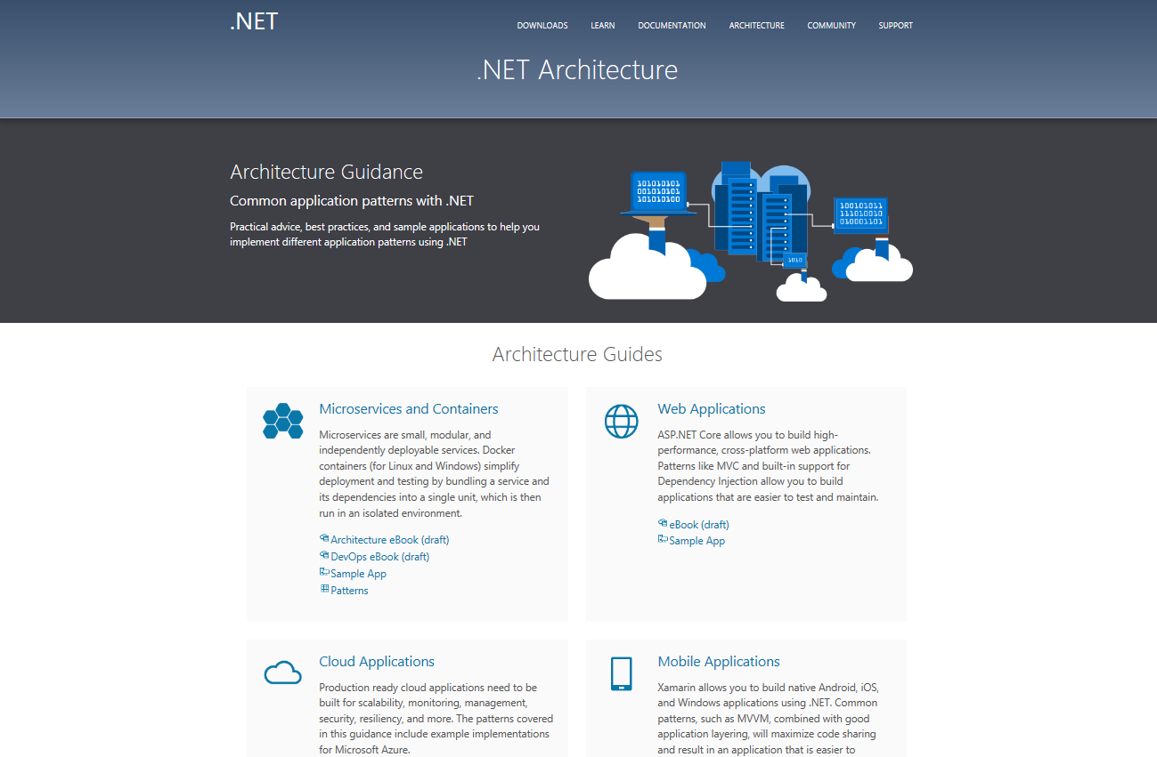
.NET Architecture Guidance
dot.net/architecture

Slide 31
Key takeaways
Microservices offer great benefits but also new challenges
Microservices are not suitable for all apps, but for large, scalable and long-term evolving applications
Containers solve many deployment issues
Containers will be ubiquitous, soon, now!
Notes:
This slide is required. Do NOT delete. This should be the first slide after your Title Slide. This is an important year and we need to arm our attendees with the information they can use to Grow Share! Please ensure that your objectives are SMART (defined below) and that they will enable them to go in and win against the competition to grow share. If you have questions, please contact your Track PM for guidance. We have also posted guidance on writing good objectives, out on the Speaker Portal (https://www.mytechready.com).
This slide should introduce the session by identifying how this information helps the attendee, partners and customers be more successful. Why is this content important?
This slide should call out what’s important about the session (sort of the why should we care, why is this important and how will it help our customers/partners be successful) as well as the key takeaways/objectives associated with the session. Call out what attendees will be able to execute on using the information gained in this session. What will they be able to walk away from this session and execute on with their customers.
Good Objectives should be SMART (specific, measurable, achievable, realistic, time-bound). Focus on the key takeaways and why this information is important to the attendee, our partners and our customers.
Each session has objectives defined and published on www.mytechready.com, please work with your Track PM to call these out here in the slide deck.
If you have questions, please contact your Track PM. See slide 5 in this template for a complete list of Tracks and TPMs.

Slide 32
Cesar de la Torre
Sr. Program Manager
.NET Product Team
Microsoft Corp.
Glenn Condron
Sr. Program Manager
ASP.NET Product Team
Microsoft Corp.
Twitter: @cesardelatorre
Email: cesardl@microsoft.com
Twitter: @condrong
Email: glennc@microsoft.com

Slide 33

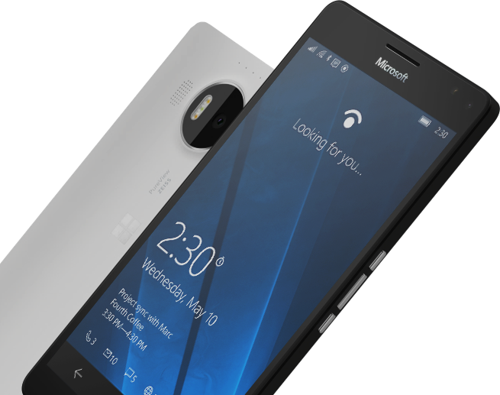
Please Complete An Evaluation Form for every session you attend.
Your input is important!
#MSBuild

Slide 35
Demo: eShopOnContainers

